Slide 1

Correlating situational context and language use New methods for an evolving theory of register
Jesse Egbert, Northern Arizona University
Douglas Biber, Northern Arizona University
Daniel Keller, Northern Arizona University

Slide 2
Background
Traditionally,
Linguistic variables → quantitative, continuous scales
Situational variables → qualitative register categories
More recently,
Situational variables → continuous situational space
(Biber, et al., 2020; Egbert, et al., forthcoming)
Present study
Linguistic variables
Situational variables
+ Relationships between them
→ Quantitative, continuous scales

Slide 3
Methods
n = 849 texts randomly sampled from the Corpus of Online Registers of English (CORE)
Linguistic analysis
Nine MD dimensions for each text from Biber & Egbert (2016)

Slide 4
Linguistic dimensions (Biber & Egbert, 2016)
Oral-involved vs. Literate-informational
Oral elaboration
Oral narrative vs. Written information
Reported communication
Irrealis vs. Informational narration
Procedural/explanatory discourse
Literate stance
Description of humans
Non-technical description

Slide 5
Methods
n = 849 texts randomly sampled from the Corpus of Online Registers of English
Linguistic analysis
Nine MD dimensions for each text from Biber & Egbert (2016)
Situational analysis
Code each text for a set of 23 continuous situational parameters (1-6 scales)

Slide 6
Situational scales (Biber, Egbert & Keller, 2020)
The text is:
a spoken transcript.
lyrical or artistic.
pre-planned and edited.
interactive.
The author/speaker:
is an expert.
focuses on himself/herself.
assumes technical background knowledge.
assumes cultural/social knowledge.
assumes personal knowledge about self.
The purpose of this text is to:
narrate past events.
explain information.
describe a person, place, thing or idea.
persuade the reader.
entertain the reader.
sell a product or service.
give advice or recommendations.
provide 'how-to' instructions.
express opinion
The basis of information is:
common knowledge
direct quotes
factual/scientific evidence
opinion
personal experience

Slide 7
Methods
n = 849 texts randomly sampled from the Corpus of Online Registers of English
Linguistic analysis
Nine MD dimensions for each text from Biber & Egbert (2016)
Situational analysis
Code each text for a set of 23 continuous situational parameters (1-6 scales)
Two independent coders
MD analysis of situational parameters

Slide 8
Situational Dimension 1: ‘Personal opinionated discourse versus technical information supported with evidence’
Situational characteristics with positive loadings
The text is: interactive (.39)
The author: focuses on self (.66), assumes personal knowledge about self (.46)
The purpose: persuade the reader (.51), entertain the reader (.46), give advice or recommendations (.50), express opinion (.81)
The basis of information: common knowledge (.37), opinion (.84), personal experience (.76)
Situational characteristics with negative loadings
The text is: pre-planned and edited (-.62)
The author: is an expert (-.61), assumes technical background knowledge (-.36)
The purpose: explain information (-.57)
The basis of information: factual scientific evidence (-.75)

Slide 9
Situational Dimension 2: ‘Narrative, entertaining discourse versus other communicative purposes (explanatory, advice, or procedural discourse)’
Situational characteristics with positive loadings
The text is: a spoken transcript (.36), lyrical or artistic (.35)
The author: assumes cultural social knowledge (.47)
The purpose: narrate past events (.61), entertain the reader (.48)
The basis of information: direct quotes (.45)
Situational characteristics with negative loadings
The purpose: explain information (-.39), give advice or recommendations (-.69), provide how-to instructions (-.66)

Slide 10
Methods
n = 849 texts randomly sampled from the Corpus of Online Registers of English
Linguistic analysis
Nine MD dimensions for each text from Biber & Egbert (2016)
Situational analysis
Code each text for a set of 23 continuous situational parameters (1-6 scales)
Two independent coders
MD analysis of situational parameters
Correlations between linguistic and situational dimensions
Canonical correlation analysis to identify latent multivariate relationships among the two sets of dimensions

Slide 11
Correlations
 | LING_D1 | LING_D2 | LING_D3 | LING_D4 | LING_D5 | LING_D6 | LING_D7 | LING_D8 | LING_D9
SIT_D1 | 0.61 | 0.31 | -0.32 | 0.22 | 0.35 | -0.10 | 0.08 | -0.08 | -0.27
SIT_D2 | -0.22 | -0.42 | -0.15 | -0.13 | 0.06 | -0.02 | 0.35 | 0.30 | -0.22

Slide 12
Canonical correlation analysis
i.e. ‘Multiple multiple regression’
Goal: Identify latent multivariate relationships among variables from two sets of variables

Slide 13
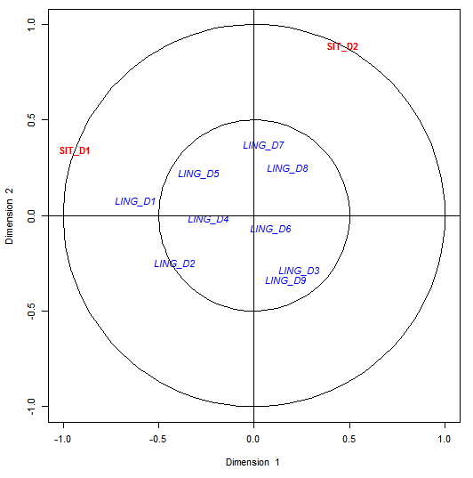
Canonical correlation analysis
Two significant canonical variates (p < .05)
CV₁: R² = .50
CV₂: R² = ..42

Slide 14
Canonical correlation analysis
Canonical variate 1—Oral narrative versus Literate information
Positive Dimensions
SIT_D2: Narrative, entertaining discourse LING_D3: Oral narrative LING_D8: Description of humans LING_D9: Non-technical description
Negative Dimensions
SIT_D1: Technical information supported with evidence LING_D1: Literate-Informational LING_D2: NOT Oral elaboration LING_D4: NOT Reported communication LING_D5: Informational narration

Slide 15
Canonical correlation analysis
Canonical variate 2—Personal stance and entertainment
Positive Dimensions
SIT_D1: Personal opinionated discourse SIT_D2: Narrative, entertaining discourse LING_D1: Oral-involved LING_D5: Informational narration LING_D7: Literate stance LING_D8: Description of humans
Negative Dimensions
LING_D2: NOT Oral elaboration LING_D3: NOT Oral narrative LING_D6: NOT Procedural/explanatory discourse LING_D9: NOT Non-technical description

Slide 16
Conclusions
Situational variables can be reliably measured in continuous quantitative terms
Independent analyses of linguistic features and situational parameters yield distinct, yet complementary results
Strong and interpretable relationships exist between dimensions of linguistic and situational variation
Canonical correlation analysis can be used to identify and interpret these multivariate relationships

Slide 17
Further reading
Biber, D. & Egbert, J. 2016. Register variation on the searchable web: A Multi-Dimensional analysis. Journal of English Linguistics. 44(2): 95-137.
Biber, D., Egbert, J. & Keller, D. 2020. Reconceptualizing register in a continuous situational space. Corpus Linguistics and Linguistic Theory.
Egbert, J., Wizner, S., Keller, D., Biber, D., Baker, P., & McEnery, T. (forthcoming). Identifying and describing functional conversation units in the BNC Spoken 2014. Text & Talk.

